Slide 1

PRESIDENTIAL
Around The World

Slide 2
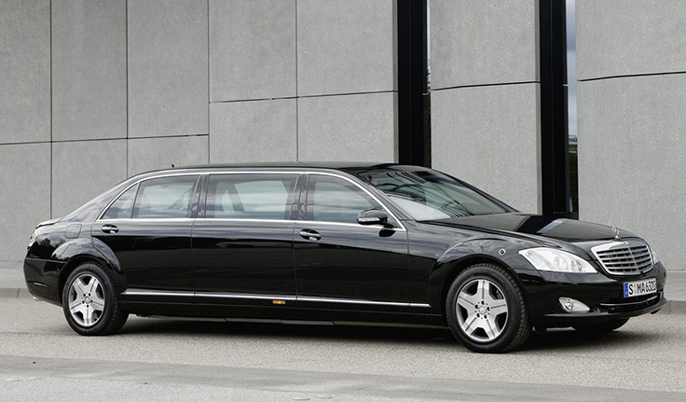
INDIA
Mercedes Benz S600 W221
Pullman Limousine
The heavily armored vehicle is ballistic-resistant. Not only can it block gunshots, it is also designed to withstand grenade attacks.
The stereo sound system has a hard drive-based GPS Satellite Navigator.
An automatic call is made for help if any of the eight dual-stage air bags or seat belt tensioners gets deployed.
The car is tested for protection against AK 47 and hand grenades of different makes.
Its current cost is a whopping Rs. 12 crores

Slide 3
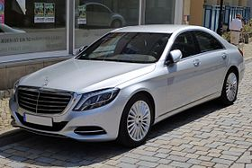
PAKISTAN
Mercedes-Benz S-Class (W222)
This specially designed car for Pakistani President has dynamic sensors, safety mode, vehicle anti radar system, electronic stability program and night view assist.
Car has latest features like infrared, active body control, personal GPS satellite navigation system.

Slide 4
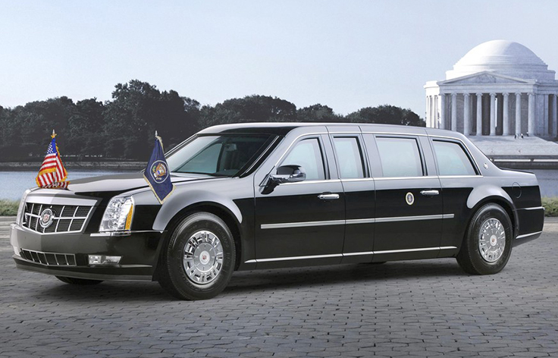
UNITED STATES
Cadillac One
Nickname : "The Beast“
'The Beast' is armour-plated, eight inches thick and heavier than a cabin door on a Boeing 757 jet.
A lock safety mechanism seals off the car like a bank vault in case of an emergency.
Obama's seat has an executive package featuring a foldaway desktop, laptop computer with wi-fi, state-of-the-art satellite phone and a direct line to the vice president and the Pentagon.
The windows on Obama's limo are reportedly 5 to 6 inches thick, bomb-proof, and can withstand armour-piercing bullets.
The interior of Obama’s limo is rumoured to be completely sealed in case of a chemical attack.
Defense Equipments : Night-vision cameras, pump-action shotguns, and tear-gas cannons.
Cost : $ 300,000

Slide 5
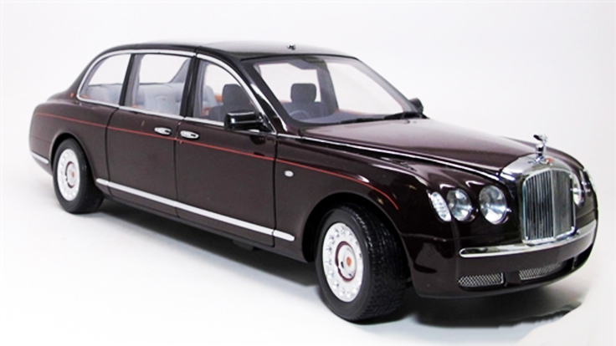
UNITED KINGDOM
Bentley State Limousine
It is equipped with broad suicide doors, which are hinged at the rear and open almost 90 degrees.
The car also has opaque rear window panels that can be removed to allow increased visibility when the occupant is attending a public event.
For protection of its occupants, the bodywork and glass are armoured, the cabin can be sealed air-tight in case of gas attack and is also blast-resistant, and the tyres are kevlar-reinforced.

Slide 6
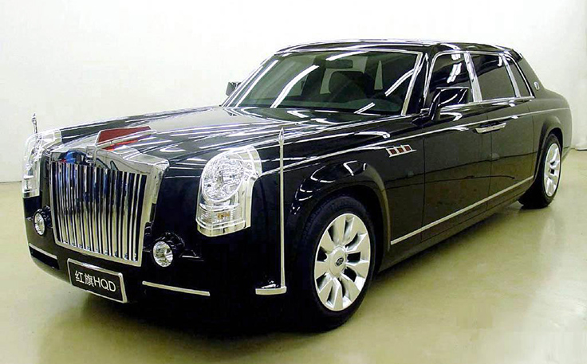
CHINA
Hongqi Limousine
The HQE is powered by an aluminium V12 cylinder engine of Chinese design (designation CA12VG), with a displacement of 6.0 liters and producing 370 kW (470 hp) at 5600 rpm and 550 N m (405 lb·ft) of torque at 4400 rpm.
It is bulletproof, completely hand built and comes with run flat tyres.
Cost : $ 800,000 (Approx.)

Slide 7
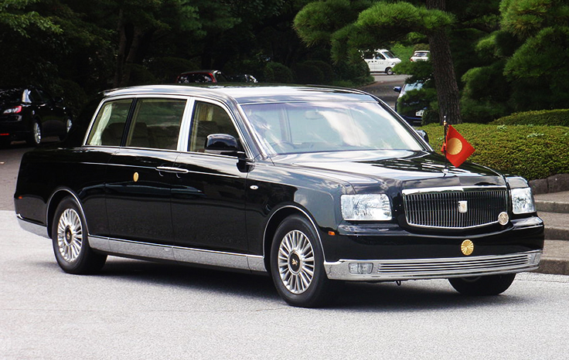
JAPAN
Toyota Century Royal
This bulletproof car is 20 feet (6.2 meter) long and 6.5 feet (2 meters) wide, with extra amenities such as bulletproofing and a granite entryway.
The Prime Minister of Japan travels in a conventional Toyota Century or Lexus LS 600h L, escorted by a police motorcade which comprises numerous Toyota Celsiors.
Cost : $ 500,000

Slide 8
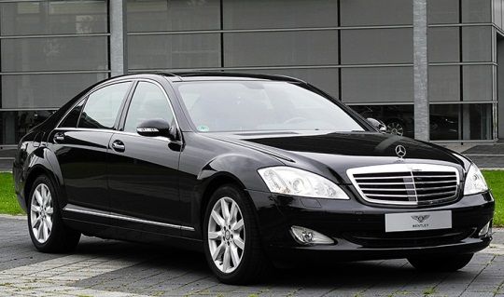
GERMANY
Mercedes-Benz S600 L
It has Brake Assist Plus that uses the radar to apportion brake pressure based on sensor data and measured distance between the car and vehicles or other objects in front.
The W221 contains many other safety features, including front and rear crumple zones, eight dual-stage air bags, anti-lock brakes (ABS), collapsible steering column, and traction control.
The car pool includes armored limousines from all German car manufacturers, usually high-end models such as the Audi A8, Volkswagen Phaeton, BMW 7 Series and Mercedes-Benz S-Class.

Slide 9
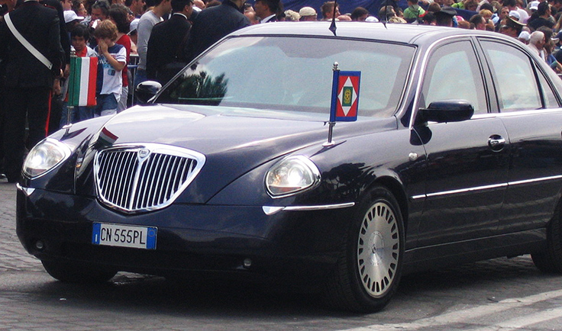
ITALY
Lacia Thesis
The current President of Italy uses two identical armored Lancia Thesis, with a third unarmored car kept as backup. A Lancia Thesis Stola S85 limousine and three Maserati Quattroporte are used to serve visiting heads of state.
They are bulletproof and have radar adaptive cruise control.

Slide 10
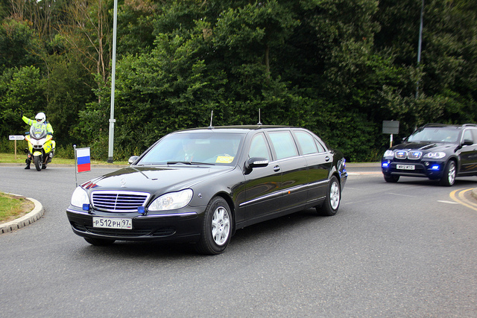
RUSSIA
Mercedes S-Class Limousine
The limousine is bulletproof, has solid rubber tires, and carries an array of communications equipment.
The presidential motorcade is escorted by police motorcycle outriders and various support vehicles.

Slide 11
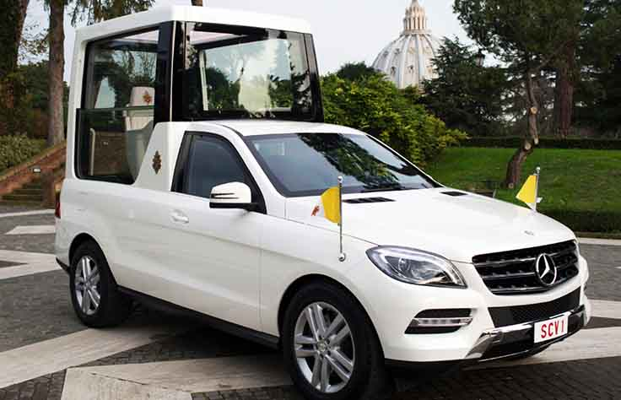
VATICAN
Mercedes-Benz M-Class
The car has an armoured glass compartment at the back.
In 2014, Pope Francis shunned the use of the armored vehicle and opted for open-air Popemobiles so he may get close to the people more

